Slide 1
Magic Of Micro-Controller
An Intensive Training Course on Micro-Controller
Brought To You By TechShopBD.Com

Slide 2
Topics
Basic Electronics
Digital Logics and Number Systems
Schematic Designing
Software Simulations
PCB Designing

Slide 3
Digital Logics
A Digital Logic Gate is an electronic device that makes logical decisions based on the different combinations of digital signals present on its inputs.

Slide 4
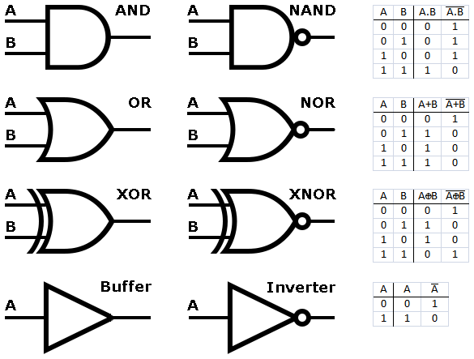
Digital Logics

Slide 5
Digital Logics

Slide 6
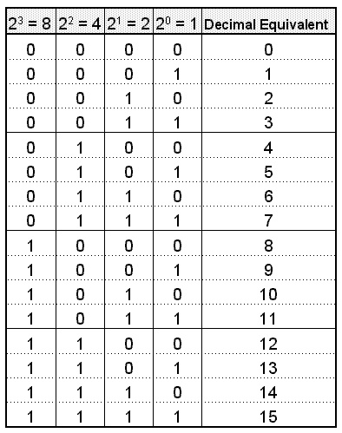
Digital Number Systems

Slide 7
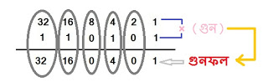
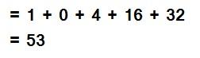
Digital Number Systems
Binary to Decimal Conversion
http://onlinebdelectronics.blogspot.com/2013/09/blog-post_12.html

Slide 8
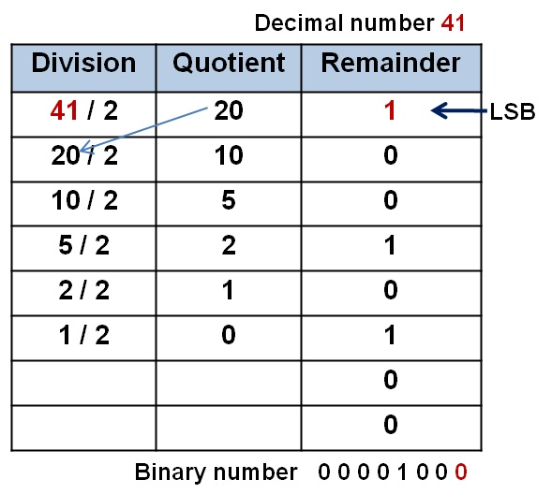
Digital Number Systems
Decimal to Binary Conversion
http://onlinebdelectronics.blogspot.com/2013/09/blog-post_337.html

Slide 9
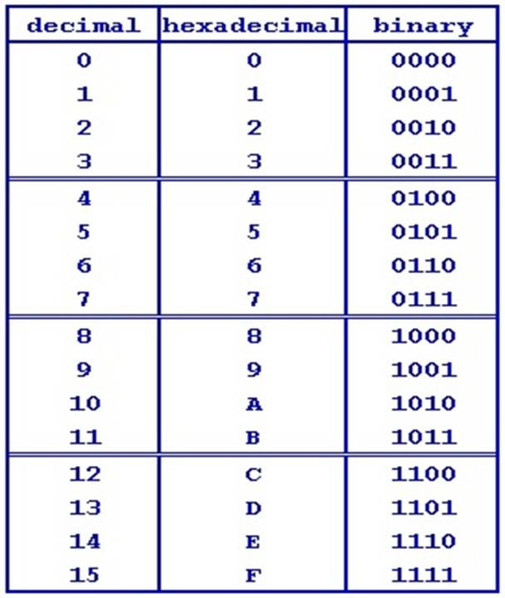
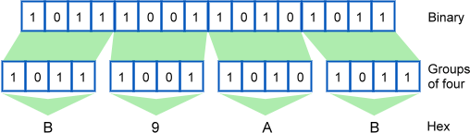
Digital Number Systems
Binary to Hex Conversion
http://onlinebdelectronics.blogspot.com/2013/09/blog-post_337.html

Slide 10
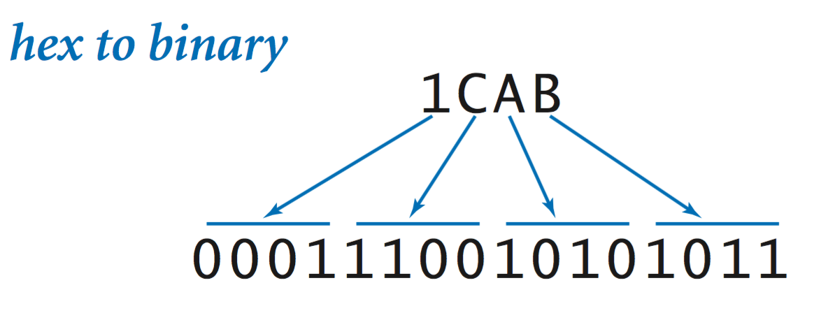
Digital Number Systems
Hex to Binary Conversion
http://onlinebdelectronics.blogspot.com/2013/09/blog-post_337.html

Slide 11
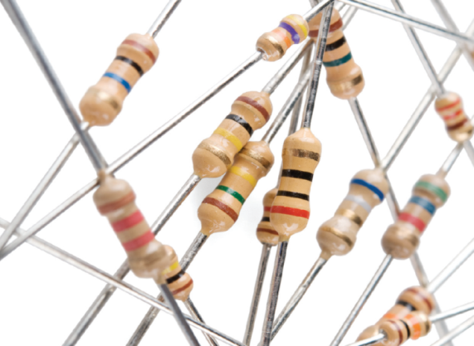
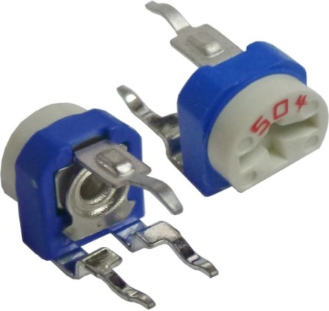
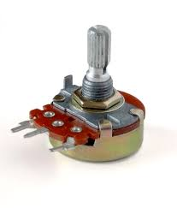
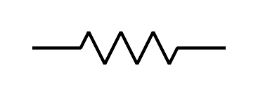
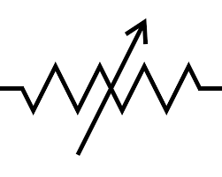
Basic Electronics
Resistor
Resistor
Variable Resistor
http://onlinebdelectronics.blogspot.com/2013/06/blog-post_4945.html

Slide 12
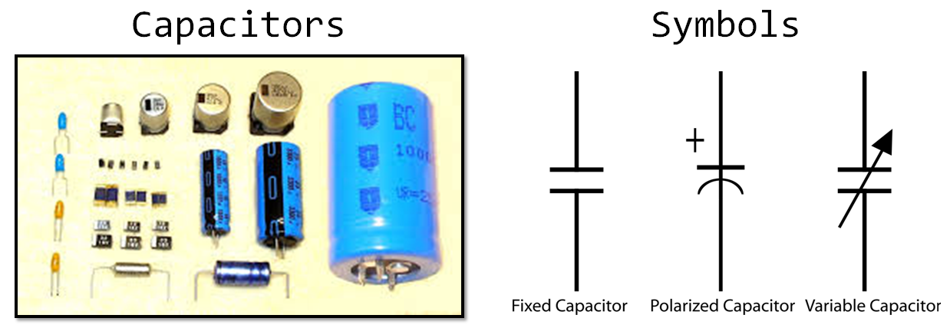
Basic Electronics
Capacitor
http://onlinebdelectronics.blogspot.com/2013/06/blog-post_29.html

Slide 13
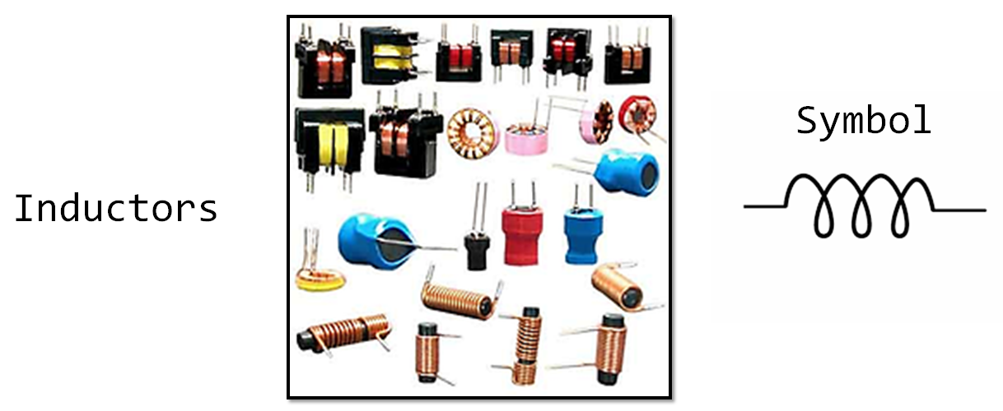
Basic Electronics
Inductors
http://onlinebdelectronics.blogspot.com

Slide 14
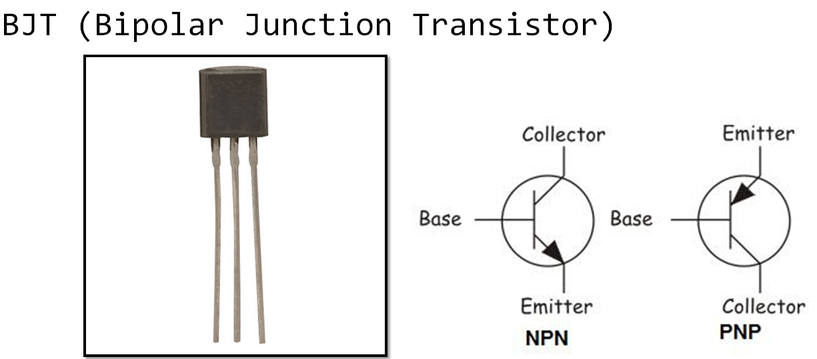
Basic Electronics
Transistor
http://onlinebdelectronics.blogspot.com/2013/10/blog-post_19.html

Slide 15
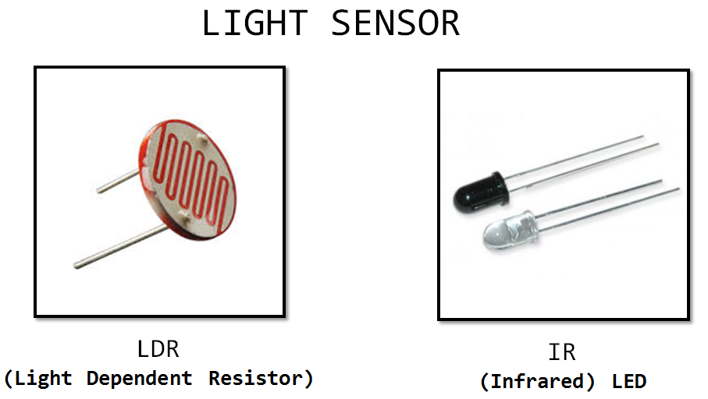
Basic Electronics
Sensor
http://onlinebdelectronics.blogspot.com

Slide 16
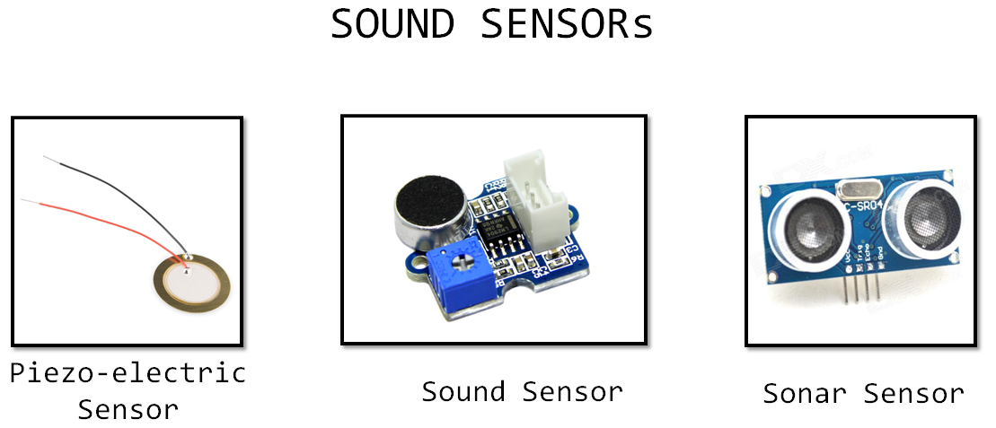
Basic Electronics
Sensor
http://onlinebdelectronics.blogspot.com

Slide 17
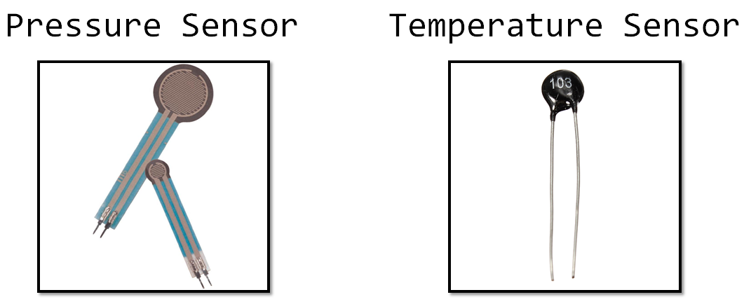
Basic Electronics
Sensor
http://onlinebdelectronics.blogspot.com

Slide 18


Slide 19
Thank You

